Slide 1
Figures by species
Present – seasonal maps, 2 depths
Future 245 – seasonal maps, 2 depths
Future 585 – seasonal maps, 2 depths
Future 245 – decadal and hovmuller
Future 585 – decadal and hovmuller

Slide 2
Dungeness Crab

Slide 3
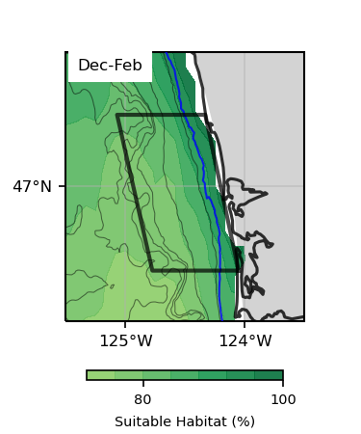
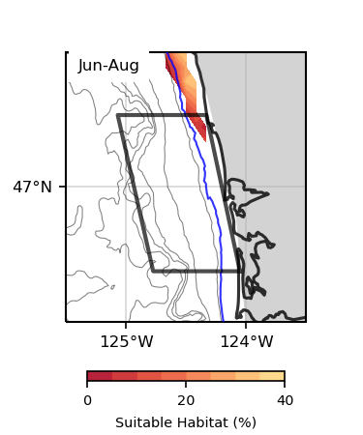
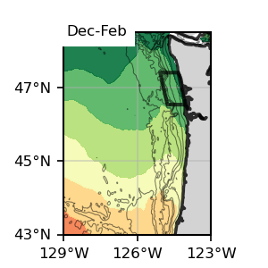
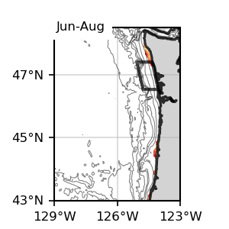
Surface
Surface
Dungeness Crab
Surface, present SSP245

Slide 4
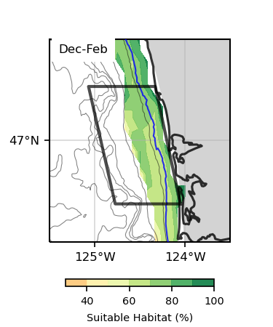
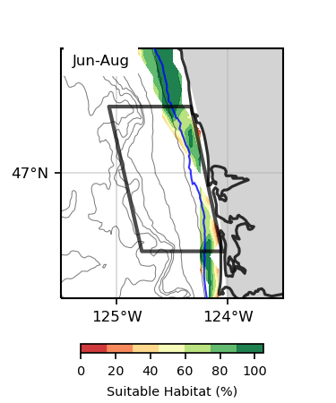
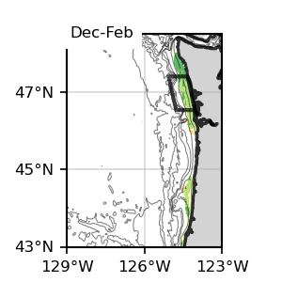
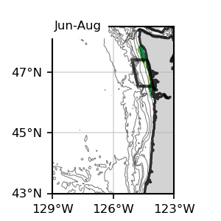
Bottom
Bottom
Dungeness Crab
Bottom, present SSP245

Slide 5
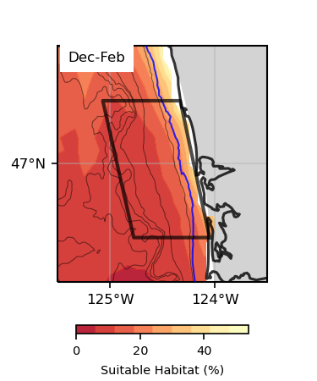
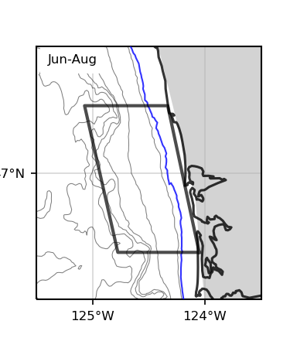
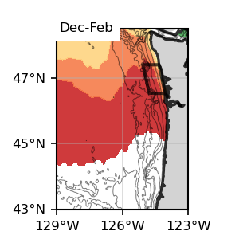
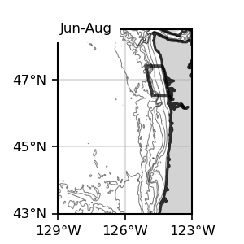
Surface
Surface
Dungeness Crab
Surface, Future, SSP 245

Slide 6
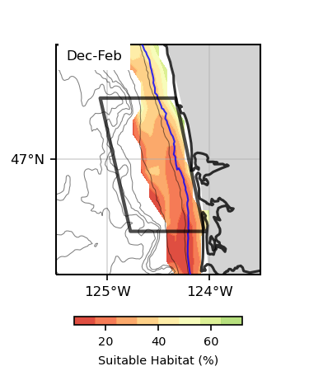
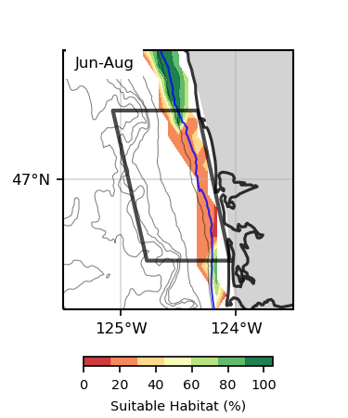
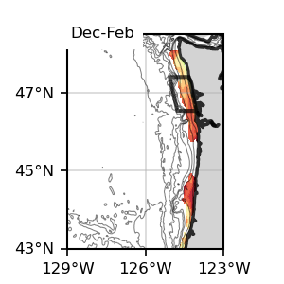
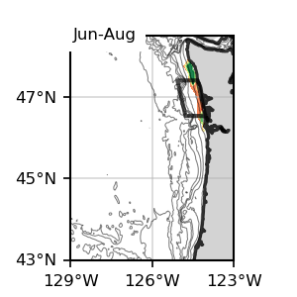
Bottom
Bottom
Dungeness Crab
Bottom, Future, SSP 245

Slide 7
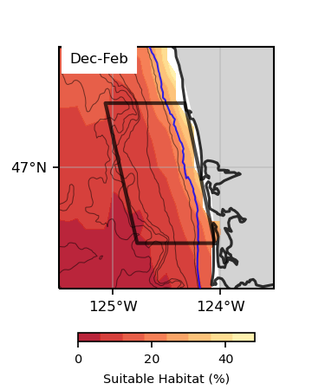
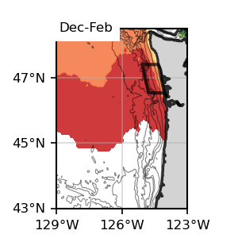
Surface
Surface
Dungeness Crab
Surface, Future, SSP 585

Slide 8
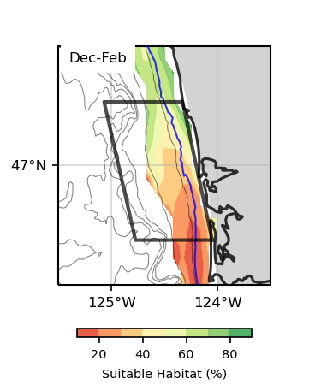
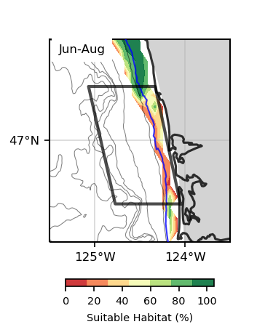
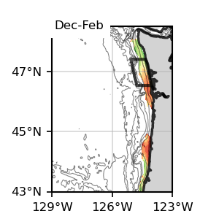
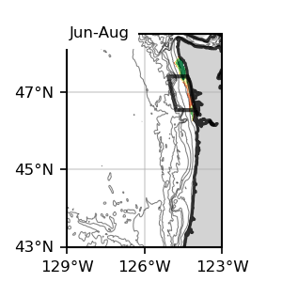
Bottom
Bottom
Dungeness Crab
Bottom, Future, SSP 585

Slide 9
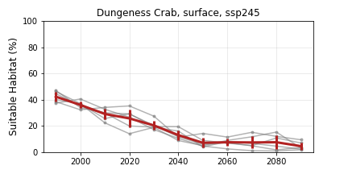
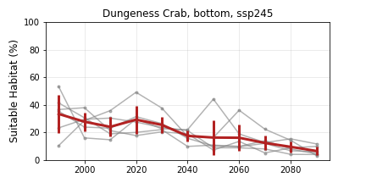
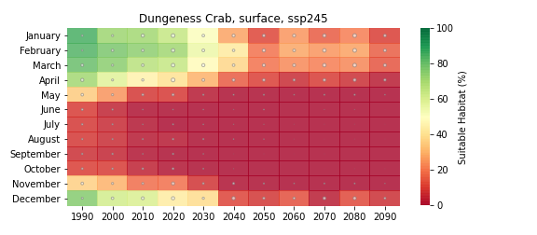
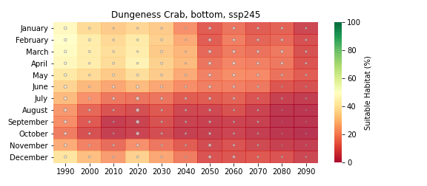
Dungeness Crab
Future, SSP 245

Slide 10
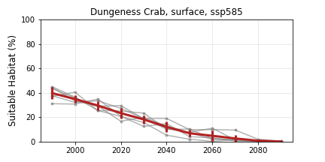
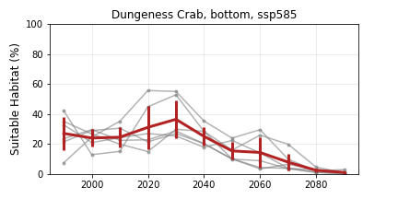
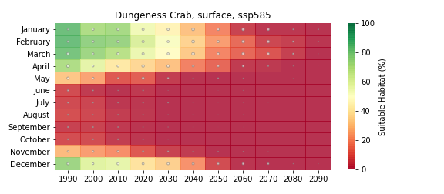
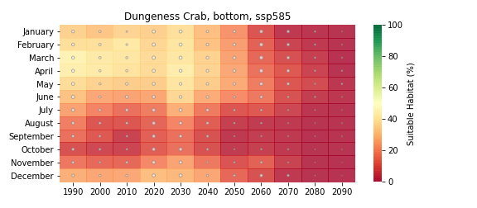
Dungeness Crab
Future, SSP 585

Slide 11
Sablefish

Slide 12
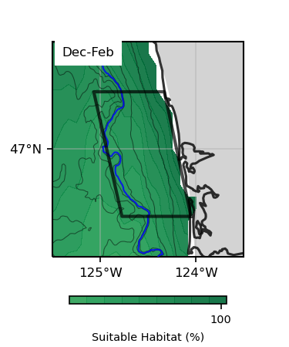
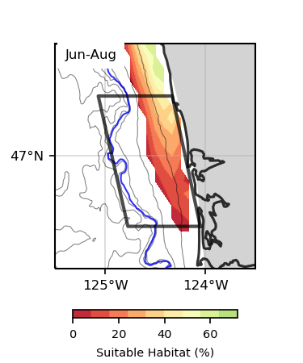
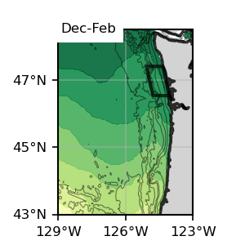
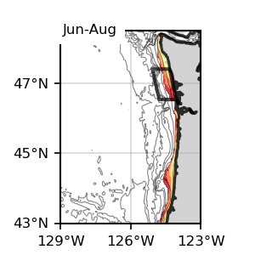
Surface
Surface
Sablefish
Surface, present SSP245

Slide 13
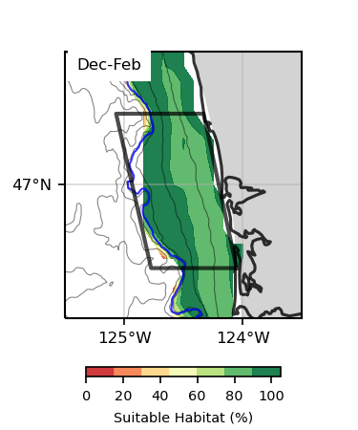
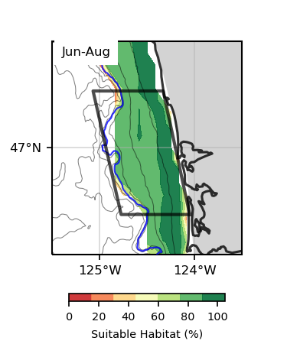
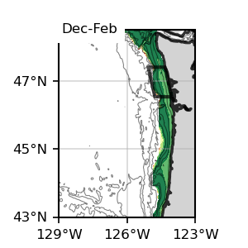
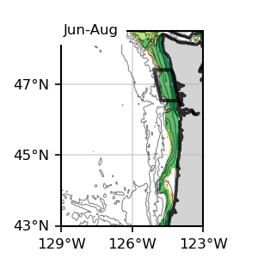
Bottom
Bottom
Sablefish
Bottom, present SSP245

Slide 14
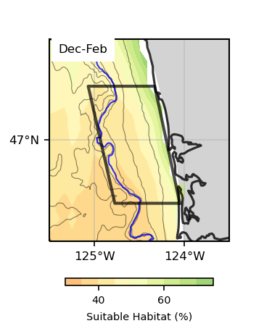
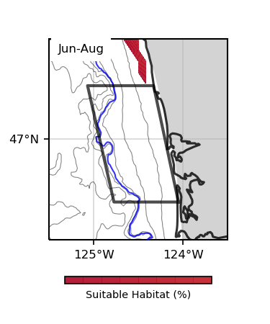
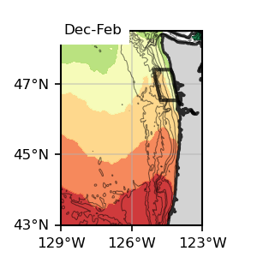
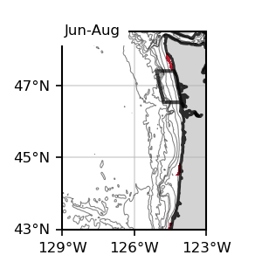
Surface
Surface
Sablefish
Surface, Future 245

Slide 15
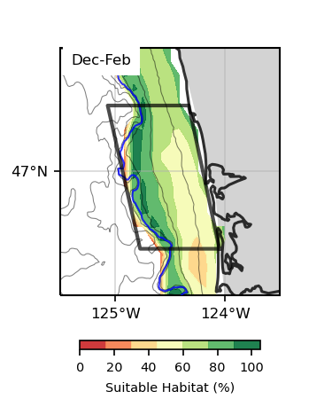
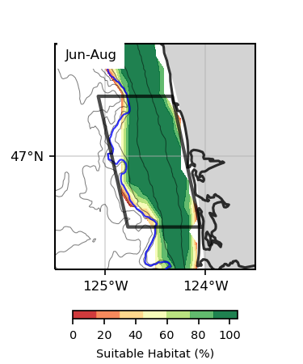
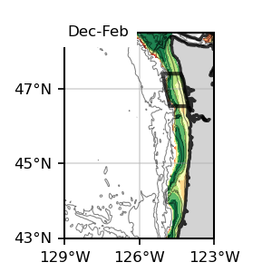
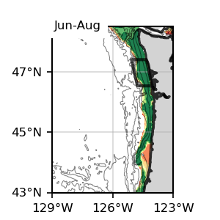
Bottom
Bottom
Sablefish
Bottom, Future 245

Slide 16
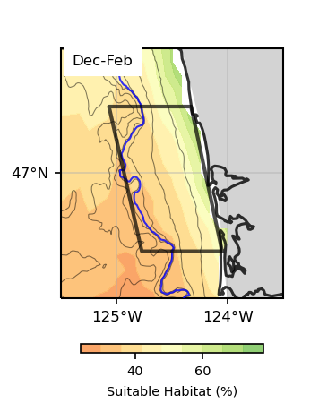
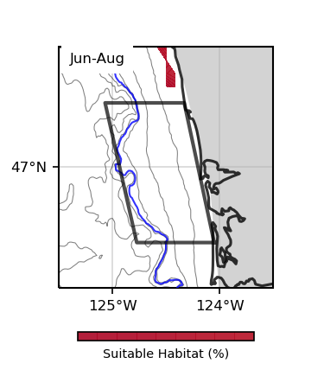
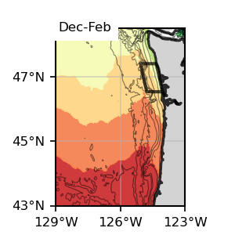
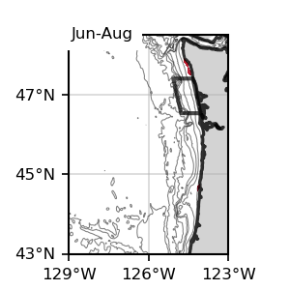
Surface
Surface
Sablefish
Surface, Future 585

Slide 17




Bottom
Bottom
Sablefish
Bottom, Future 585

Slide 18




Sablefish
Future 245

Slide 19




Sablefish
Future 585

Slide 20
Halibut

Slide 21



Surface
Surface
Halibut
Surface, present SSP245

Slide 22




Bottom
Bottom
Halibut
Bottom, present SSP245

Slide 23



Surface
Surface
Halibut
Surface, Future 245

Slide 24




Bottom
Bottom
Halibut
Bottom, Future 245

Slide 25

Surface
Surface
Halibut
Surface, Future 585

Slide 26




Bottom
Bottom
Halibut
Bottom, Future 585

Slide 27




Halibut
Future 245

Slide 28




Halibut
Future 585

Slide 29
Chinook

Slide 30




Surface
Surface
Chinook
Surface, present SSP245

Slide 31




Bottom
Bottom
Chinook
Bottom, present SSP245

Slide 32



Surface
Surface
Chinook
Surface, Future 245

Slide 33




Bottom
Bottom
Chinook
Bottom, Future 245

Slide 34


Surface
Surface
Chinook
Surface, Future 585

Slide 35




Bottom
Bottom
Chinook
Bottom, Future 585

Slide 36




Chinook
Future 245

Slide 37




Chinook
Future 585

Slide 38
Coho

Slide 39




Surface
Surface
Coho
Surface, present SSP245

Slide 40




Bottom
Bottom
Coho
Bottom, present SSP245

Slide 41



Surface
Surface
Coho
Surface, Future 245

Slide 42




Bottom
Bottom
Coho
Bottom, Future 245

Slide 43


Surface
Surface
Coho
Surface, Future 585

Slide 44




Bottom
Bottom
Coho
Bottom, Future 585

Slide 45




Coho
Future 245

Slide 46




Coho
Future 585

Slide 47
Razor Clams

Slide 48




Surface
Surface
Razor Clams
Surface, present SSP245

Slide 49




Bottom
Bottom
Razor Clams
Bottom, present SSP245

Slide 50




Surface
Surface
Razor Clams
Surface, Future 245

Slide 51




Bottom
Bottom
Razor Clams
Bottom, Future 245

Slide 52



Surface
Surface
Razor Clams
Surface, Future 585

Slide 53




Bottom
Bottom
Razor Clams
Bottom, Future 585

Slide 54




Razor Clams
Future 245

Slide 55




Razor Clams
Future 585

Slide 56
Albacore

Slide 57




Surface
Surface
Albacore
Surface, present SSP245

Slide 58

Bottom
Bottom
Albacore
Bottom, present SSP245

Slide 59




Surface
Surface
Albacore
Surface, Future 245

Slide 60
Bottom
Bottom
Albacore
Bottom, Future 245

Slide 61




Surface
Surface
Albacore
Surface, Future 585

Slide 62
Bottom
Bottom
Albacore
Bottom, Future 585

Slide 63




Albacore
Future 245

Slide 64




Albacore
Future 585

